Slide 1


March 2, 2026

Slide 2




Working Solutions | Award‑Winning, On‑Shore, On- Demand CX Expertise
What Makes Working Solutions an Industry Leader
Award/Industry Recognition | Award Description
🏆 CCW 2025 BPO of the Year | Recognized for CX innovation, AI-human blend & regulated delivery (linkedin.com, workingsolutions.com,
🎓 Remote Tech Learning Platform of the Year | Highlights our SALT-based training excellence
🌐 FlexJobs #1 Remote-Work BPO 2025 | Top-rated remote employer & virtual CX provider workingsolutions.com)
30 Years of Onshore CX Leadership
Three decades of proven leadership in onshore customer experience solutions, shaping industry standards since 1996
Flexible, on-demand support from U.S. and Canada-based agents with deep CX expertise
Trusted by Fortune 500, mid-market, and high-growth brands to deliver seamless, scalable service
Fractional Workforce Innovators
Nearly 30 years of innovation in flexible customer experience staffing
No volume minimums, offering clients ultimate deployment flexibility
Rapid scalability to meet surge needs and shifting business demands
Culture‑Aligned Execution
Culture-aligned delivery that mirrors each client's values, voice, and brand identity
Seamless brand representation across all customer interactions, driven by deep immersion in client culture
Authentic customer experiences that strengthen trust, loyalty, and brand consistency
Onshore-first, AI-supported, and fully scalable - trusted for CX excellence in regulated industries.

Slide 3
Critical Challenges WSOL can solve for Dovenmuehle
Challenge #1: Volume Surge (Unexpected volume spikes cause operational disruption)
Our on-demand workforce offers unmatched flexibility, allowing clients to scale up or down quickly based on seasonal demands or changing business needs.
This efficient model reduces operational costs while increasing productive hours
The result is stronger collections performance and overachievement of KPIs
Challenge #2: Attrition (An employee loss causes service gaps, quality reduction and high training costs)
WSOL has access to a committed talent pool, as our marketing attracts 10K–30K applicants monthly, ensuring a deep and diverse talent pool.
Our proven selection methodology identifies top-tier professionals with the skills and mindset for complex financial conversations and skills to deliver strong performance
Education: Teacher-led Instruction by degreed educators with AI simulation. Faster ramp time
Challenge #3: Operational Efficiency (Overworked/low empathy FTEs can lead to repeat calls & unkept promises)
Variable staffing model (3:1 ratio) reduces fixed costs while maintaining quality and delivering strong outcomes
Performance-based billing model ensures clients only pay for productive agent hours—no wasted spend. No insurance benefits, hardware expense, PTO, breaks, overtime.

Slide 4











Dovenmuehle will benefit from WSOL's Strategic Value Propositions
1. WSOL offers experience in Financial services
2. Fortune 500 companies count on WSOL to bring immediate 'flex' to critical situations
3. "IBM of the BPO Industry"- Best in Class Provider, Reliable, Reputable, Referenceable
4. Technology Agnostic allowing leverage of any tech stack /system
4

Slide 5
Financial Services and Collections Experience
High-touch support for collections and financial services clients
Key Service Areas:
Where we deliver value
First‑Party Collections & Payment Arrangement Support
Early‑stage collections
Past‑due payment outreach
Right‑party contact and repayment negotiations
Payment arrangement support
Seasonal delinquency spikes
Call Spikes due to economic fluctuations
Scale up operations for new client acquisitions
✅Ensure borrowers receive reliable, compliant, and professional experiences during sensitive financial conversations. ✅Eliminates cost and risk of fixed headcount while ensuring service levels stay strong—especially during unpredictable call surges. ✅ WSOL is a proven partner that can deliver high‑quality, brand‑aligned borrower interactions while reducing operational strain on internal teams.
Client Examples:
Provided collections support for their Spotloan product
Provided outbound sales and collections support for Direct Energy customers
Provide B2B and B2C support for Quickbooks and TurboTax customers

Slide 6
Efficient Operating Model Flexes with Call Volume Demand
High Flex model catches the peaks in volumes and efficiently handles valleys

Slide 7
Ongoing Attrition & Onboarding: What is the long-term impact?
Attrition Model (1 FTE)
Working Solutions Model
Cost Category | Key Factors Included | Typical Estimate per Agent
Separation | Exit interviews, administrative processing, severance pay. | $500 - $1,500
Recruitment | Advertising, screening, recruiter time, background checks. | $2,000 - $3,500
Onboarding | Equipment setup, HR documentation, initial orientation. | $1,500
Training | Trainer salaries, material costs, trainee wages (non-productive). | $3,500
Productivity Gap | Lost sales, overtime for other staff, slow ramp-up of new hires. | 1.5x - 2x Annual Salary
Total |  | $10,000
Cost Category | Key Factors Included | Typical Estimate per Agent
Set up Costs | Recruiting and Hiring Technical Provisioning of Users System and Security Compliance | $500
Remote Agent Prep | Education and Training Systems and Operations Policy and Procedures | $3,700 (4 weeks training)
Total |  | $4,200

Slide 8

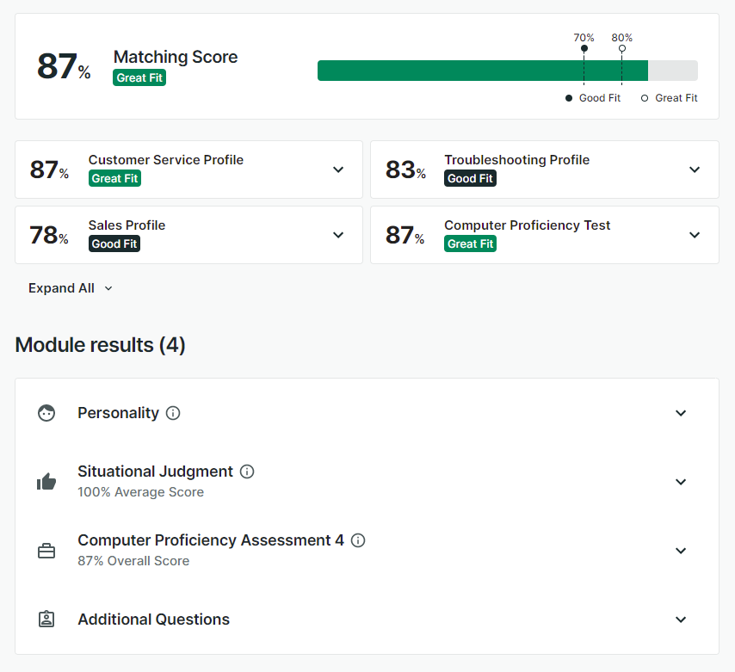
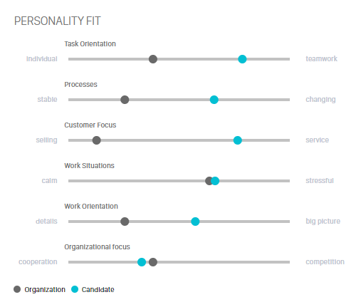
Decades of Data, One Perfect Match: How We Choose the Right PRO
Proven assessments help match high-performing agents to your most complex, high-value programs.
Featured Agent Profile – “The Analytical Negotiator”
Name: Brenda T. (sample profile) Background: Brenda is a former debt settlement agent who transitioned to remote work post-COVID. She has a track record of delivering fast, empathetic resolution in high-pressure situations.
Performance Summary:
Matching Score: 87% – Great Fit
Top Fit Categories:
Customer Service Profile – 87%
Computer Proficiency – 87%
Situational Judgment – 100%
Personality Fit Highlights:
Balanced across task and teamwork
High resilience under stress
Strong detail orientation and service mindset
Ideal Program Fit:
Analytical and problem-solving skills (software or telco)
Troubleshooting-based roles
Client onboarding or activation services

Slide 9
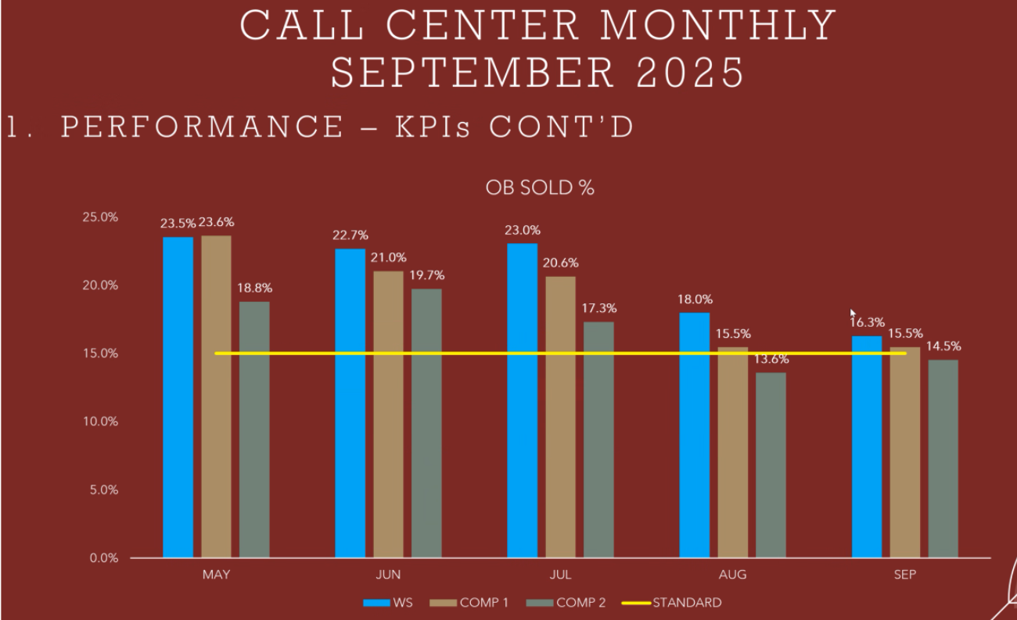
Setting a New Standard Above Tenured Teams
Notes:
The above is an example of Working Solutions in the blue beating out internal as well as other partners in outbound sales sold percentages on our Centerfield client. (Insurance client). Generate outbound referrals. People who have submitted a request online. Leads are transferred to a licensed agent.

Slide 10
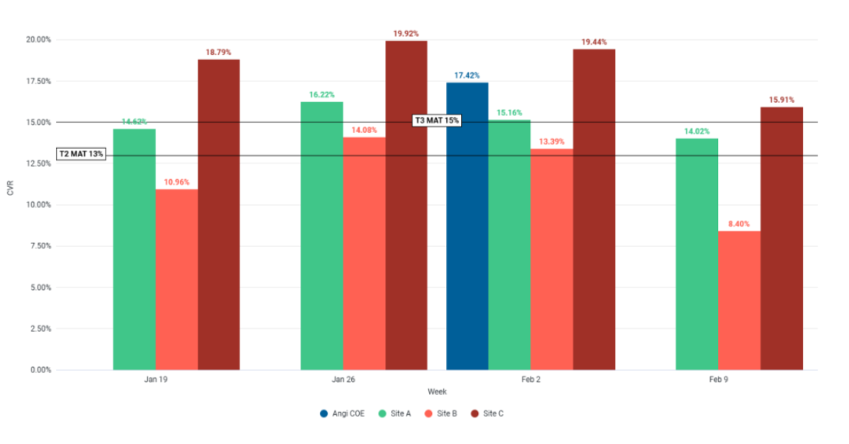
Working Solutions Surpassing In‑House Performance
Notes:
The below reflects conversion on our Angi client-we are site C and the blue is the Angi client’s internal center of excellence so it’s a big deal that we continue to beat them. Facilitate connection between homeowner and contractors/ service provider. Upsell opportunities. WSOL is site C on the graph.

Slide 11
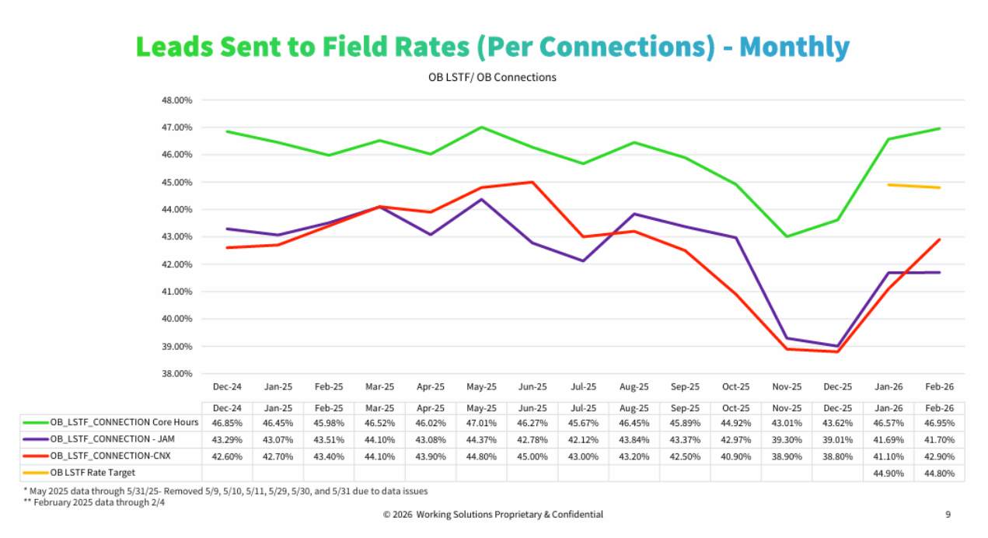
Notes:
The above reflects conversion on our Angi client-we are site C and the blue is the Angi client’s internal center of excellence so it’s a big deal that we continue to beat them. 😊

Slide 12



Recent Case Studies
Use Case: Always short by about 25 staff in peak season, never outsourced before. Brand/Culture was of critical importance.
Solution: Collaboratively built ideal agent profile for recruitment (familiarity with the brand, right personality and experience fit, etc). Onboarded and trained 50 agents in 5 weeks, immersed in culture and brand. Launched program for 2022 Q4 Holiday season.
Use Case: 16,000 flight cancelations in December 2022 created a 6-month backlog of refund requests. US Secretary of Transportation commanded SWA to process them in less than a month.
Solution: Sourced and trained 900 agents in 7 days, co-wrote training material, adjudicated 200,000 refund cases in three weeks.
Use Case: TCNA sought a higher quality outsourcer to replace a well-respected, global, publicly traded outsourcing firm. 100% of the call center activities outsourced by TCNA.
Solution: Collaboratively built ideal agent profile for recruitment (familiarity with the brand, right personality and experience fit, localized bi-lingual dialects, etc). Onboarded and trained 300 agents in eight weeks. Program cutover in April 2023.
“Boscov’s has never outsourced customer care and I was very concerned about protecting our brand and culture. I learned I had nothing to worry about and Working Solutions has done a better job with our customers than I could have imagined. We could not have gotten through the holiday without them!”
Maria Tenreiro | Customer Care, Director
“So appreciate all y’all did for Southwest, and I LUV how we pulled together. Let’s find another (less stressful) reason to do it again!”
Tim Scott | Manager, Sourcing & SWA Staffers
Talent Acquisition
“We selected Working Solutions because of the very unique approaches to agent staffing and scheduling, the high priority they place on agent training and their commitment to high quality customer interactions. They have completely delivered on all expectations!”
Dan Fisher | Service Operations Director

Slide 13
Operational Excellence in Action: Your Program Success Team
Vice President - Operations
WFM
Director Program Success
Recruiting
Marketing
WFM/Operational
Insights
Technology
Finance
Program Assistant
Agent and Program Support
Program Success Manager
Team Resources
Agent Support/SME 15:1 Ratio
Program Performance Manager
Performance Specialist
Agent Performance & Coaching
QA Specialist
Agent Monitoring/Review 25:1 Ratio
Development Manager
Development Specialist
Agent Coaching/Ongoing Education
Notes:
The support team is built to scale as program grows

Slide 14


Commitment to Security
Risk Governance
Risk aware culture
Process for identifying/assess risks
Process for evaluate impact, mitigating
Monitor, reporting, and continuous improvement
Security Policies
Access to systems/data, provisioning, authentication, authorization, user reviews
Encryption of data
Breach mitigation and reporting
Staff training on policies, cyber threats
Cyber Security
Agents separated from corporate network
Endpoint security deployed
Beyond Identity and 2FA
Regular virus/software updates, employee cyber training
Change Management
Requests reviewed by CRB
Approval and testing
Implementation and rollback plans
Documentation, monitor and report
Business Continuity
Our model is inherently geared to business continuity
Agents separate from corporate network
Change management controlled by change review board
Multiple instances of Azure cloud
© 2025 Working Solutions Proprietary & Confidential

Slide 15
Project Implementation Page 1
Launch team and leaders
Draft-For Discussion Only
designated prep
—
12/12/22
12/14/22
System test
readout plan
Technology in final
Operational Go-Live
Environment ready for testing
configuration
Working Solutions/Client
Project kickoff
12/29/2022
Roster Closed
4/7/23
Contractual Signed
1/5/2023
1/11/2023
1/31/2023
12/12/2022
12/15/2022
12/18/2022
12/25/2022
1/1/2023
1/8/2023
1/15/2023
1/22/2023
1/29/2023
2/5/2023
2/12/2023
2/19/2023
2/26/2023
3/5/2023
4/2/2023
Tech infrastructure created
Rapid system testing
Tech adjustments
Access and operationalize technology solutions
12/16/22 - 12/28/22
12/30/22 - 1/5/22
1/6/23 - 1/9/23
1/12/23 - 1/25/23
Obtain launch team credentials
Create agent setup instructions
12/14/2022 - 12/29/2022
1/6/23 - 1/19/23
Launch team discovery sessions
Create and operationalize reports to meet agent pay, invoicing
12/16/22 - 12/28/22
1/6/23 - 1/26/23
Agent recruitment
Agent Credentials Created
Agent tech setup sessions
Agent Prep
1/4/23 - 1/31/23
2/2/23 - 2/14/23
2/16/23 - 2/28/23
3/1/23 - 4/4/23
Train The Trainer Sessions
Client provides rapid support team (RST)
Lock in Agent Pay Strategy,
1/6/23 - 2/2/23
2/15/23 - 3/2/23
Company Holiday
Finalize Posting
Operational Go-Live
Launch Team Works All Program Launch Deliverables
Curriculum creation
12/23/22 - 12/26/22
12/29/22 - 1/2/23
1/6/23 - 1/26/23
1/27/23 - 2/9/23
4/7/23
12/18/2022
12/25/2022
1/1/2023
1/8/2023
1/15/2023
1/22/2023
1/29/2023
2/5/2023
2/12/2023
2/19/2023
2/26/2023
3/5/2023
4/2/2023
Company Holiday
1/2/23

Slide 16
Project Implementation Page 2
Launch team and leaders
designated prep
—
12/12/22
12/14/22
Draft-For Discussion Only
Environment ready for testing
System test
readout plan
Technology in final
Operational Go-Live
Working Solutions/Client
Project kickoff
12/29/2022
configuration
Roster Closed
4/7/23
Contractual Signed
1/5/2023
1/11/2023
1/31/2023
12/12/2022
12/15/2022
12/18/2022
12/25/2022
1/1/2023
1/8/2023
1/15/2023
1/22/2023
1/29/2023
2/5/2023
2/12/2023
2/19/2023
2/26/2023
3/5/2023
4/2/2023
Tech infrastructure created
Rapid system testing
Tech adjustments
Access and operationalize technology solutions
12/16/22 - 12/28/22
12/30/22 - 1/5/22
1/6/23 - 1/9/23
1/12/23 - 1/25/23
Obtain launch team credentials
Create agent setup instructions
12/14/2022 - 12/29/2022
1/6/23 - 1/19/23
Launch team discovery sessions
Create and operationalize reports to meet agent pay, invoicing
12/16/22 - 12/28/22
1/6/23 - 1/26/23
Agent recruitment
Agent Credentials Created
Agent tech setup sessions
Agent Prep
1/4/23 - 1/31/23
2/2/23 - 2/14/23
2/16/23 - 2/28/23
3/1/23 - 4/4/23
Train The Trainer Sessions
Client provides rapid support team (RST)
Lock in Agent Pay Strategy,
1/6/23 - 2/2/23
2/15/23 - 3/2/23
Company Holiday
Finalize Posting
Operational Go-Live
Launch Team Works All Program Launch Deliverables
Curriculum creation
12/23/22 - 12/26/22
12/29/22 - 1/2/23
1/6/23 - 1/26/23
1/27/23 - 2/9/23
4/7/23
12/18/2022
12/25/2022
1/1/2023
1/8/2023
1/15/2023
1/22/2023
1/29/2023
2/5/2023
2/12/2023
2/19/2023
2/26/2023
3/5/2023
4/2/2023
Company Holiday
1/2/23

Slide 17
THANKS
Q&A/NEXT STEPS

