Slide 1
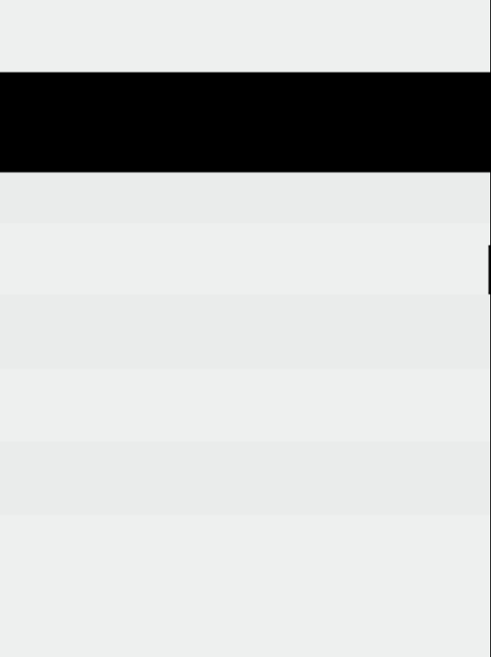
Background Check Package Options
Tier 1
Tier 2 (Plus)
Tier 3
Custom Package -
19.95
53.95
69.95
$
$
$
Cost TBD
/ agent
/ agent
/ agent
Social Security Number Trace
Sex Offender Registry Search
Terrorist Watch List Search
National Criminal Database Search
County Criminal Court Search – Current County and Name
Social Security Number Trace
Sex Offender Registry Search
Terrorist Watch List Search
National Criminal Database Search
County Criminal Court Search – Up to 3 Counties*
Federal Criminal Court Search – Current District*
OIG/SAM Sanctions
Social Security Number Trace
Sex Offender Registry Search
Terrorist Watch List Search
National Criminal Database Search
County Criminal Court Search – All Counties for prior 7 years*
Federal Criminal Court Search – All Districts for prior 7 years*
Social Security Number Trace
Add any of the following reports needed to meet your requirements:
– Wants & Warrants Search
–FACIS Search
– OIG/SAM Sanctions Search
– Credit Verification
A custom package and pricing will be built to your specifications**
*You may choose whether to include aliases within the prior 7 years. Each alias incurs an additional $7.50 charge for each County and Federal Court Search.
**We do not offer drug testing or verification reports (employment, education, reference) for our on-demand contractors. State criminal database searches are highly discouraged due to very low ROI for the cost and variance by state. Our data supports National + County as the preferred combination.

